Slide 1
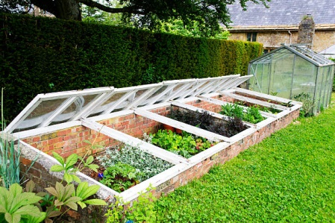
Year-Round Gardening Early Spring
Credits go to Rick Stone at
My Stoney Acres
And
Nicki Jabbour, author of “The Year-Round Gardener”

Slide 2
Why Do We Start So Early?
Adds 4-6 weeks to our garden season
The benefits of growing our garden earlier is that we can get some more cool weather plants in and then use the spot later for our summer plants.
We can get them out of the way
The cool weather plants thrive in the cool and not so well in the heat.

Slide 3
How Do We Start?
We start our cool weather seeds indoors under lights
We prepare them to go into a cold frame bed or a hoop house.
We warm up our soil if you have an in ground bed, by laying plastic over the top of the bed for about 2-3 weeks before you’re going to put your plants in.
Example of peas

Slide 4
How Do We Start?
Early Spring Veggies to plant in your cold frame or hoop house is on the list that was passed out.
The main seeds to get started indoors are
Cool weather Lettuces
Spinach, Swiss Chard, Arugula, Kale
Cole Plants: Broccoli, Cabbage, Kohlarabi brussel sprouts and Cauliflower
Peas-Early March-(covered)

Slide 5
How do we start?
Decide what type of protection you want to use for your early Spring plants
Cold Frame
Hoop House
Fabric row cover ( used for later planting)

Slide 6
The Purpose a Cold Frame or Hoop House
The purpose of these protection methods is to increase your growing season.
Eg: we are in Zone 6b but these will increase your season to Zone 7 depending on the choice of protection you choose. Cold frames gives you the best protection carrying you over the winter months into spring in some cases.

Slide 7
Our Cold Frame December 1, 2024
Buttercrunch lettuce
Mache-Corn Salad
Red & Rainbow Chard
Matador Spinach
Tat Soy
Red leaf Romaine
Carrots-Little finger

Slide 8
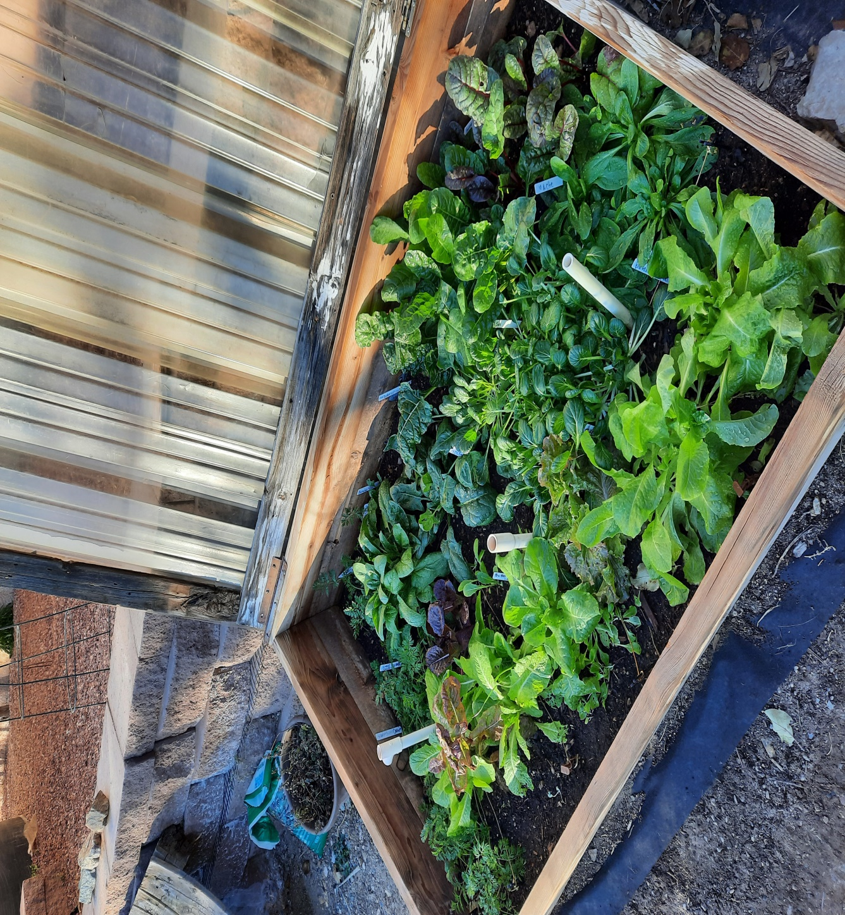

Slide 9
What is a cold frame?
At it’s most basic, a cold frame is simply a box with a clear or translucent top. Its purpose is to trap solar energy and provide protection from the elements –cold temps, excessive rain, wind and snow. The back of the box is typically taller than the front, (usually by 3-6 inches), which lets the tip of the cold frame sit at an angle. This slope allows maximum sunlight to enter the structure and will help it shed rain and snow.

Slide 10
What is a cold frame?
Cold frames can be constructed from simple, often recycled materials: use scrap wood, straw bales, bricks, and old windows.
A cold frame can be constructed as a portable device moved from bed to bed whenever a bit of protection is need. It can also be a permanent part of the garden, multitasking as a seeding bed, a spot for hardening off young seedlings, getting extra-early crops in the ground at a time when the unprotected garden is still frozen.
Using a cold frame will do the equivalent of moving a garden plot about one zone to the south. If the cold frames are southfacing, in zones 5b/6, it can create conditions of Zone 7 extending both our season and the variety of crops we can grow.

Slide 11
Types of Cold Frames
Temporary
Portable
Temporary cold frames can be just straw bales placed around your taller cold-tolerant vegetables like kale and leeks. You can just place an old window on top of the bales or a sheet of ridgid plastic.
Portable CF, you can easily carry over to your raised bed full of fall plantings and cover it to protect it from the cold. Adding a heavy row cover in the very cold part of winter will insulate the plants and you’ll be able to still harvest from them. In the spring they burst forth and grow until the April/May heat comes then it comes to a halt.

Slide 12
Cold Frames

Slide 13
Permanent Cold Frames
Permanent cold frames are permanent, in-ground structures that provide insulated and sheltered spots for growing a variety of crops throughout the year. They need to be placed in the right location to ensure maximum solar exposure. This is typically constructed from a solid material like wood or cinder blocks and the only light that reaches the plants enters the structure from the top. In very cold areas these are often sunk into the ground as it offers better insulation.

Slide 14
Brick and Window Cold Frame

Slide 15
Cold Frame ideas-Pintrest

Slide 16
Location of A Cold Frame
This is an important decision if you are putting in a permanet cold frame that will act as a raised bed in the summer. Lids can be removed in the summer
Choose a South Facing area that has good sun through out the day
Protection from the wind
Easy access to water
Close to the house
If you want to have a portable cold frame then choose a raised bed that will be in the sun even in the winter or spring that you would be able to cover with the frame.

Slide 17
Our Cold Frame
Our cold frame is located against a south facing wall to get more light. Because the dirt near the wall is really hard and no good, we put a weed barrier under it, then put soil into it.

Slide 18
Location of Cold Frame

Slide 19
Soil
Good soil is so important.
Compost adds:
nutrients, improves soil texture
Adds soil microbes
Increases water retention
Buy it in bulk from a nursery
Organic is a good choice
Worm castings is also a great additive
Always add compost to you’re winter cold frame to prepare it for Spring planting

Slide 20
Watering
After transplanting seedlings or sowing fresh seed, the soil will have to be watered more often than if the plants are mature. In the winter little to no watering is required with cold temperatures and closed frame slows evaporation.

Slide 21
My Mistakes! It may not look like one, but...

Slide 22
Temperature
Its important to ventelate your cold frame on warm days.
Keeping a thermometer in it in the shady area is important so you don’t prematurily cook your veggies!
When the temp has reached about 40 degrees outside it’s time to crack open the cover. Inside temp should be in the 50 -60 degrees range.
When outside temp is over 45 -50, open the lid completely. In the late afternoon close the frame to encourage solar energy to build up before nightfall.

Slide 23
TIP! For Cooling help
If that sounds like a pain... you can easily install a temperature-responsive automatic vent opener. It will do the work for you by propping open the lid whenever the inside temperature of the cold frame rises to 60.
Amazon carries them from $25 and up

